Slide 1
Comunication Systems

Slide 2
What is an ICT System

Slide 3
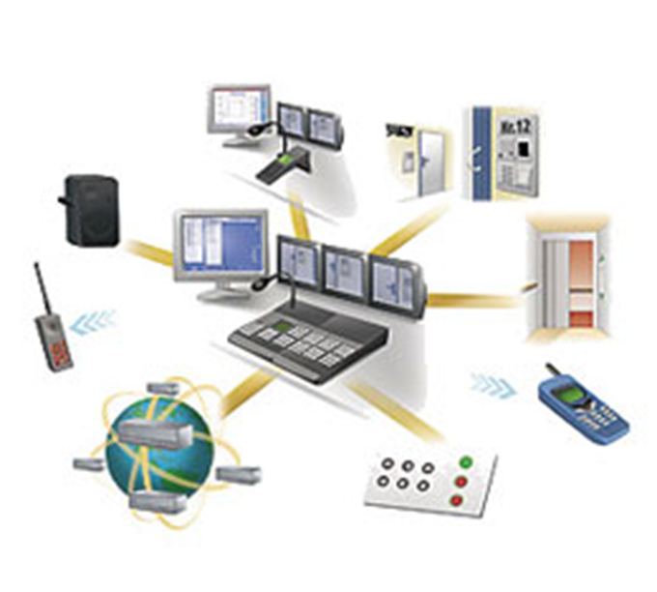
An ICT system is like a set-up consisting of hardware, software, data and all the people who them.
ICT Systems are used to send and recieve text, voice and video content.

Slide 4
types of ICT systems:
Digital radio
Digital tv
Wearable computer
Teletext
Call centre

Slide 5
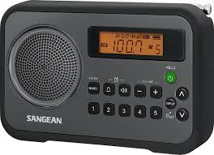
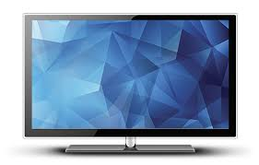
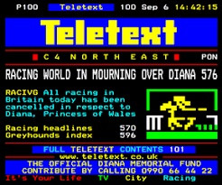
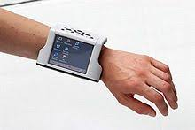

Slide 6
The Importance of ICT Systems
By using ICT systems we are:
more productive - we can complete a greater number of tasks in the same time at reduced cost by using computers than we could prior to their invention
able to deal with vast amounts of information and process it quickly
able to transmit and receive information rapidly

Slide 7
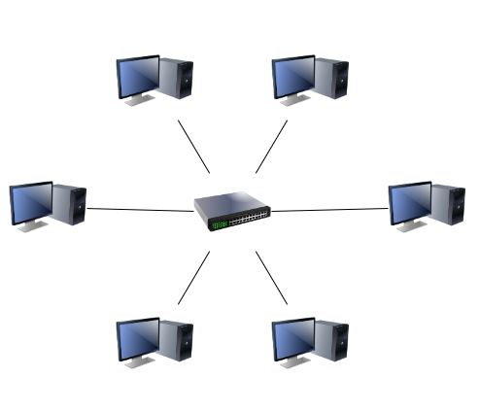
How can a PC be Conected to another computer?
One PC can be connected to another in the same building by using a Local Area Network(LAN).
One computer can also be connected to another by adding modems and connecting them to the telefones lines, this happens when they are further away from each other.

Slide 8
What are telecomunications?
Telecommunications refers to the transmission signals over a distance for the purpose of communication. Information is transmitted by devices like: telefone, radio, television, satellite, or networks)
Because of telecommunications, people can now work at home and communicate with their office by computer and telephone. This is called teleworking.

Slide 9

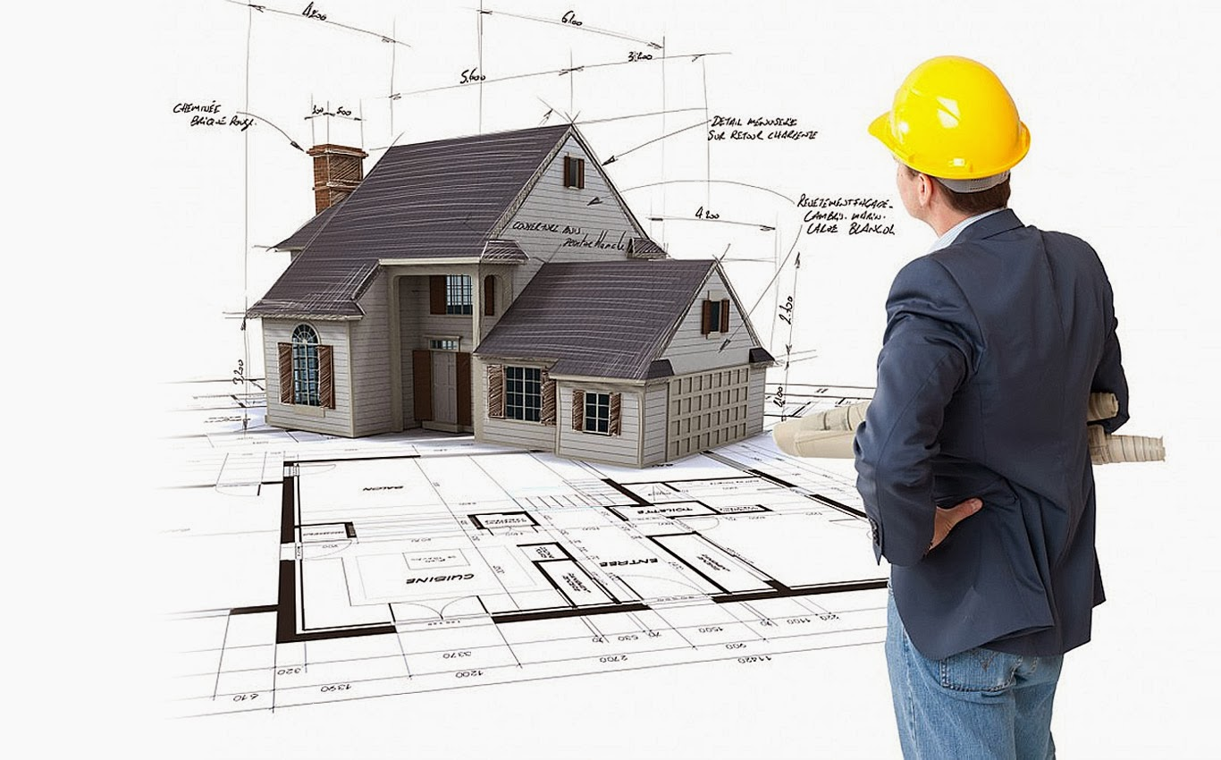
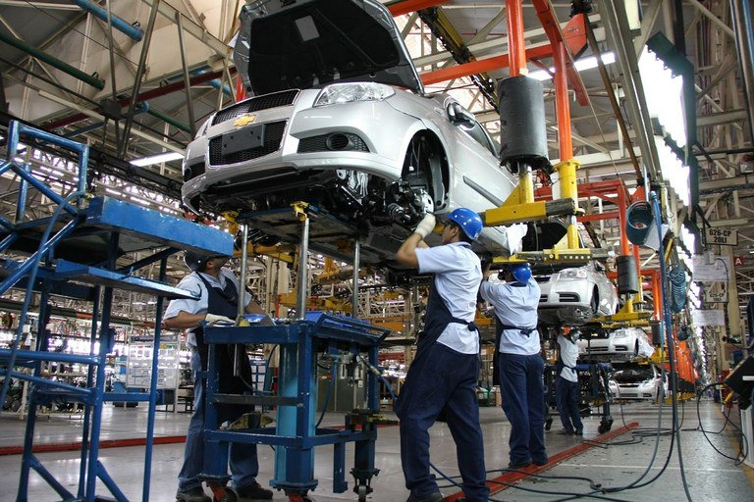

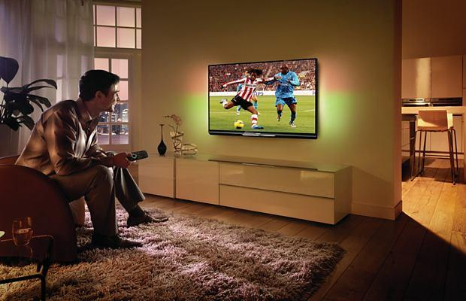

Slide 10
VoIP techonology
What exactly is VoIP?
What is na ATA? What is its function?
What are the benefits of VoIP Technology?

Slide 11
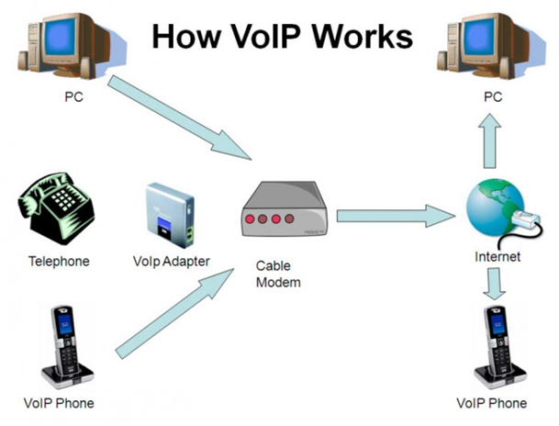
What exactly is VoIP?
Voice over Internet Protocol (VoIP) technology lets you use the Internet to make and receive telephone calls.

Slide 12
What is na ATA? What is its function?
Na ATA is na analouge telephone adapter. Its function is to convert analogue signals of your traditional phone into digital signals.

Slide 13
Benefits of VoIP Technology
Reduce travel and training costs, thanks to web and video conferencing
Easily grow your phone system as needed
Have one phone number ring simultaneously on multiple devices, helping employees stay connected to each other and to customers
Reduce your phone charges
Have a single network for voice and data, simplifying management and reducing costs
Access your phone system's features at home or at client offices, in airports and hotels—anywhere you've got a broadband connection

Slide 14
End

